Slide 1


Slide 2
培训课堂注意事项
请自觉遵守培训纪律，培训期间不得旷课，没有特殊事项，不得请假。
上课期间，请将手机调至静音状态，认真听讲，如有特殊原因需接听电话，在征得讲师同意后到教室外接听。
培训期间请提前5分钟到达教室，并及时签到，每人每节课前签到一次，不得多签或代签。

Slide 3
微软企业信息化战略之WCF

Slide 4
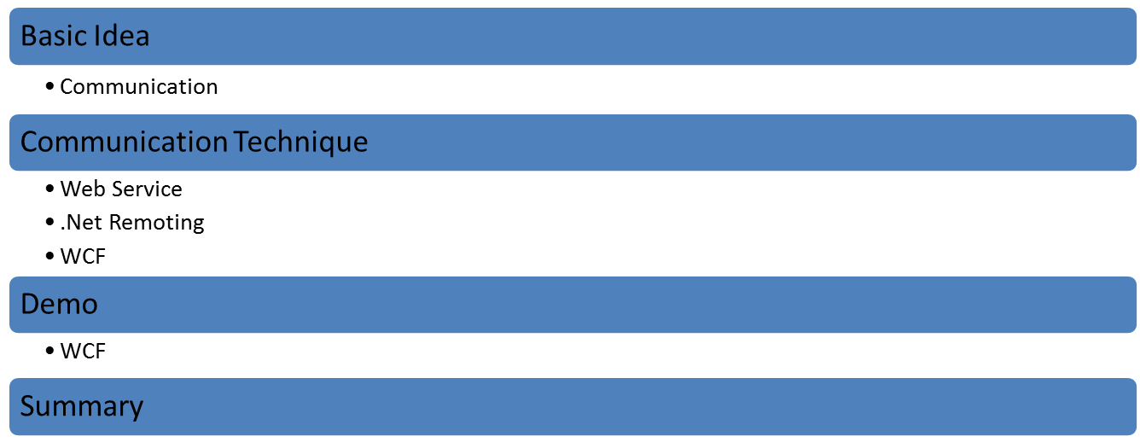
Outline

Slide 5



Basic idea - Communication

Slide 6
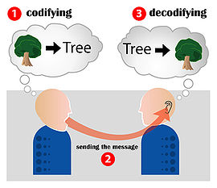
Basic idea - Communication Model
Message encoding
Transmission of the encoded message as a sequence of signals using a specific channel or medium
Message decoding.

Slide 7
Basic idea – Programs Communication
A simple way to implement programs communication (Demo)
There are many techniques

Slide 8
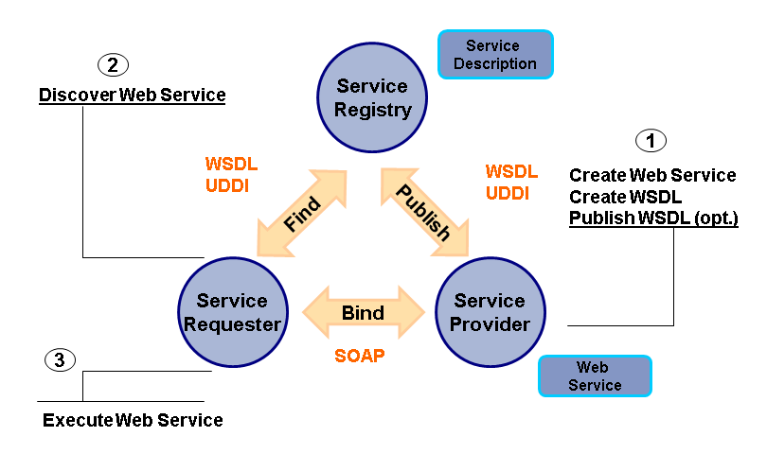
Technique – Web Service

Slide 9
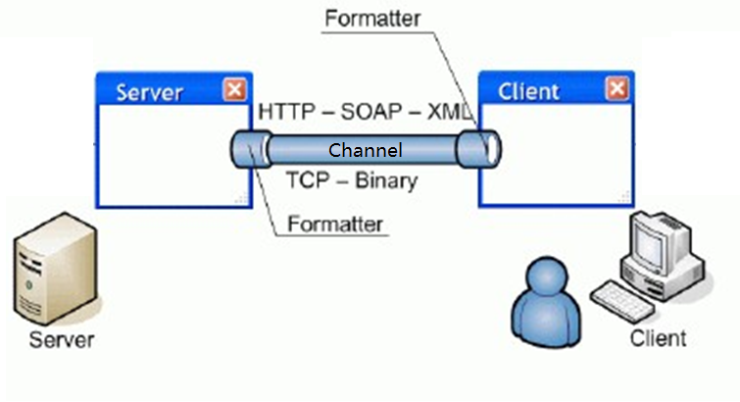
Technique – .Net Remoting (Demo)

Slide 10
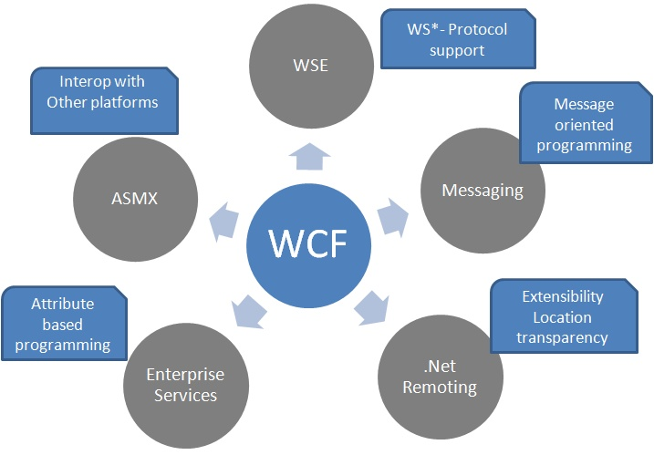
Technique – WCF(1)

Slide 11
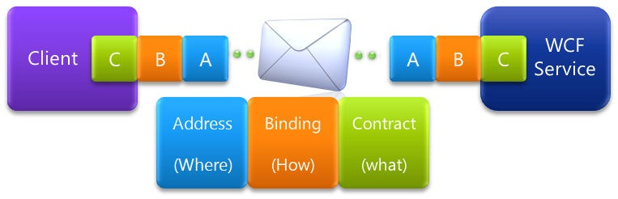
Technique – WCF(2)

Slide 12
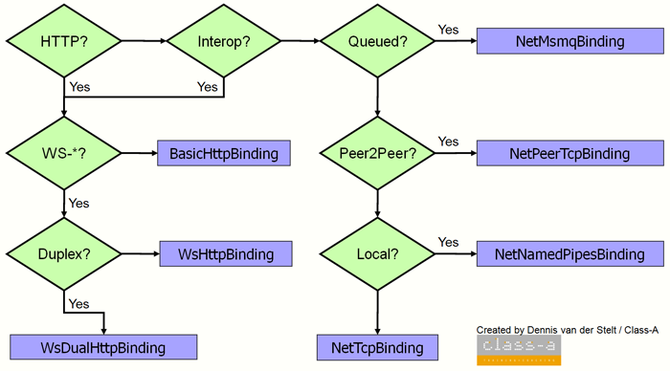
Technique – WCF(3)

Slide 13
Demo
Contract
Service
End Point
Binding

Slide 14
Summary
Integration

Slide 15
Thank you!
That's all for today.
Q&A time.

